Slide 1
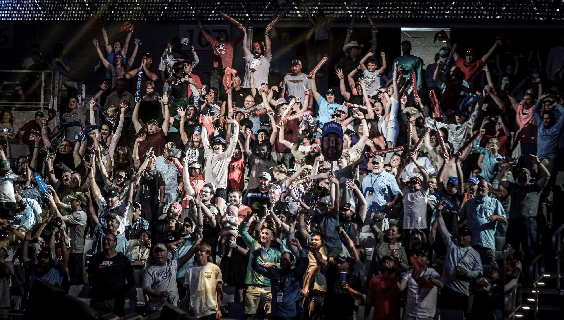
Big Bass. Big Stage. Big Dreams.
147,197 fans - Second-highest attended Classic in history!
Angler Hank Cherry cemented legendary status by becoming only the fourth back-to-back Classic champion
Economic impact for the week is expected to top $25 million
The Classic was featured in the FOX Bet Super Six App which had 220K+ unique players (topping all other sports within the application Classic week)
​
Media Coverage: The 2021 Academy Sports + Outdoors Bassmaster Classic Presented by HUK drew heavy national, international and local attention. Nationally, The Weather Channel was on-site and filing stories Thursday – Sunday. The Classic also received coverage in Bleacher Report, USA Today, MSN Sports & Travel, Yahoo Sports US & Canada, The Spun, Chicago Sun-times, Outdoor Life & Toronto Star, which was part of extensive coverage from The Canadian Press/La Presse Canadienne. Locally in Texas, we were everywhere, including Dallas Morning News, Houston Chronicle, Fort Worth Magazine, San Antonio Express-News, Katy News, Lufkin Daily News, Texas Outdoors Journal, Texas Game & Fish, Waco-Tribune Herald as well as a multitude of television affiliates.
Total Potential Audience: 774.9MM
FOX Sports LIVE Broadcast
Elite LIVE Streaming
BASSMASTER.com
Saturday (FOX) and Sunday (FS1) 8 a.m.-noon EST​
Bassmaster.com, Fox Sports app & FoxSports.com
Tournament Week
Total Reach: 1.98MM viewers
(based on a six-minute qualifier)
​
Saturday on FOX: 1.65MM Viewers
(watched at least a portion of Saturday's telecast)
​
Sunday on FS1: 459K Viewers
(watched at least a portion of Sunday's telecast)
Streams: 713K
Minutes Streamed: 20.2MM
Average minutes per stream: 30
Unique Traffic: 948K
​
Site Visits: 1.7MM
Page Views: 18MM
Source: Nielsen 2021 Live + SD, FOX Sports, Brightcove, Adobe Analytics, Cision/PR Newswire

